Slide 1
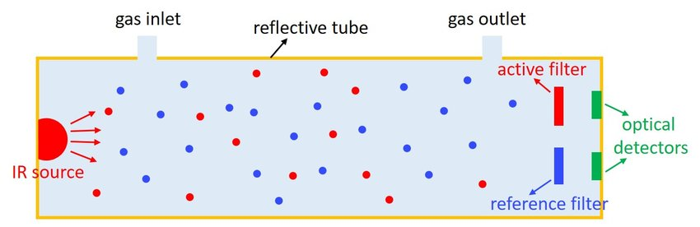
Different Circuits For NDIR GAS Sensor
Presented by-
Rishav Pandey
Under the guidance of
Dr. Ravindra Kumar Jha, Scientist, CSIR-CEERI

Slide 2
In NDIR Gas Sensors, generally two main things happen:
1. Beer-Lambert Law
2. IR-Spectroscopy

Slide 3
Different ways to detect an IR Radiation….
Thermal Detectors
1. Thermopile
2. Thermistor
3. Pyroelectric Detector
4. Bolometer
5. Golay Cell
Photodetectors (or Photon Detectors)
1. Photoconductivity Cell
2. Semiconductor Detectors

Slide 4

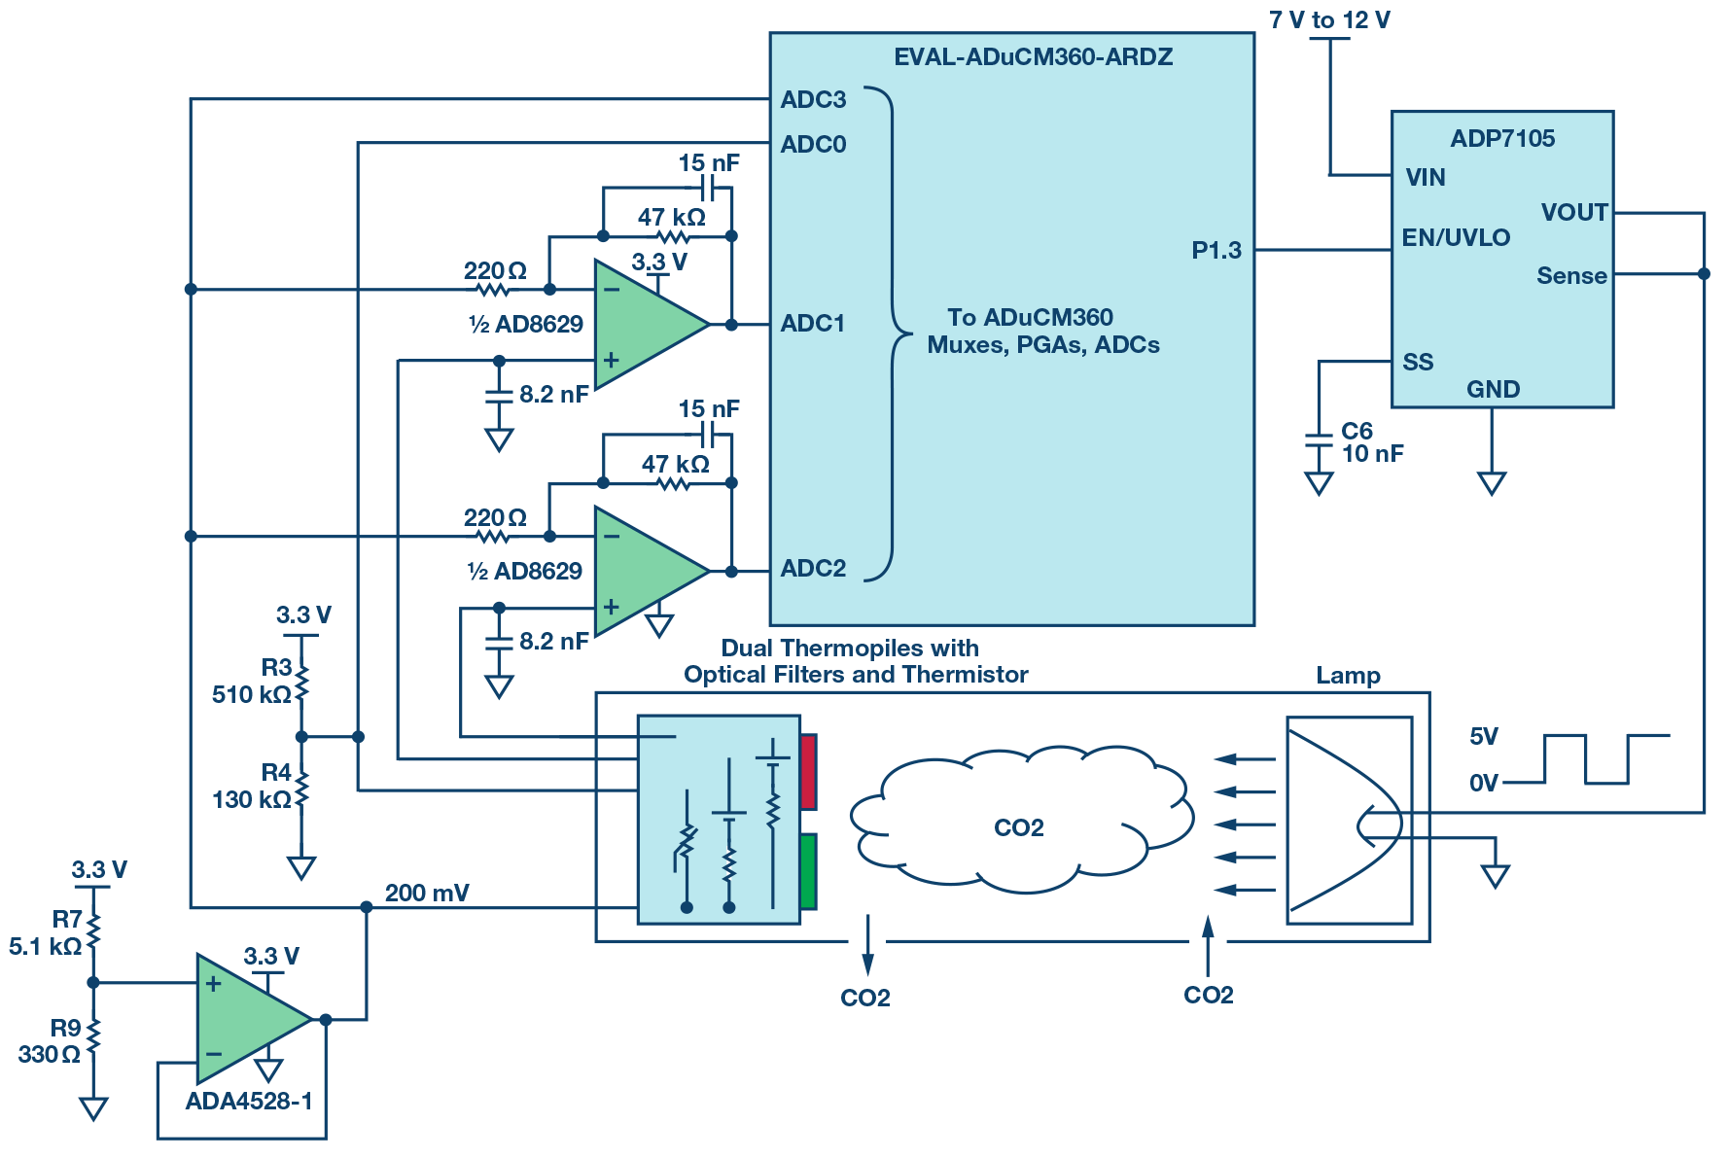
NDIR Gas Sensor Using Thermopile Detector

Slide 5

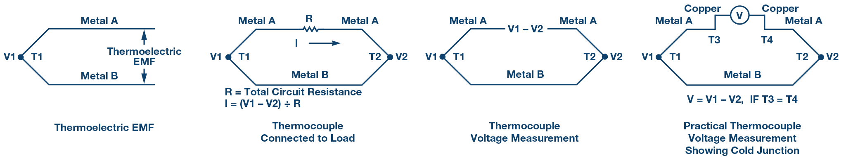
Cont….
Since, in case of a thermopile detector ( usually, series connection of thermocouples), the temperature difference between the active and the reference junction creates a potential difference, and if the later quantity is measured with a voltmeter and if we measure the temperature of reference junction using thermistor, we can calculate the concentration of the target gas.
Ex- If IR light is applied to a dual thermopile detector fitted with a pair of optical filters so that one filter is centered on 4260 nm and the other on 3910 nm, the concentration of carbon dioxide can be measured from the ratios of the two thermopile voltages.

Slide 6
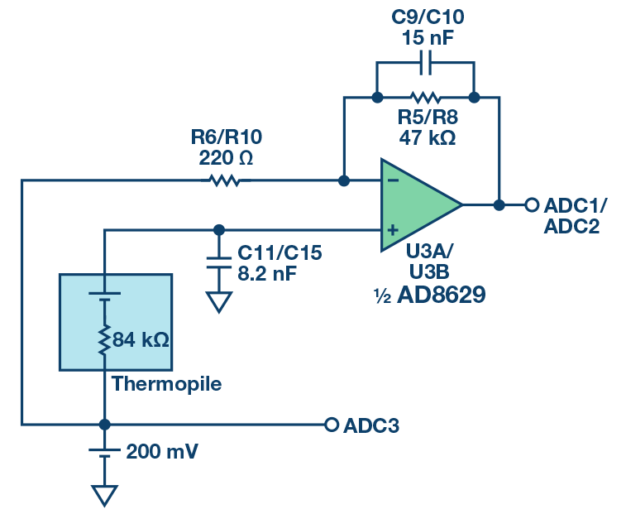
Driver Circuit for Thermopile Detector

Slide 7
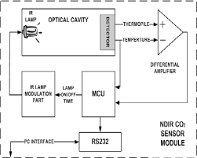
NDIR Gas Sensor Using Thermopile and Temperature Sensor

Slide 8
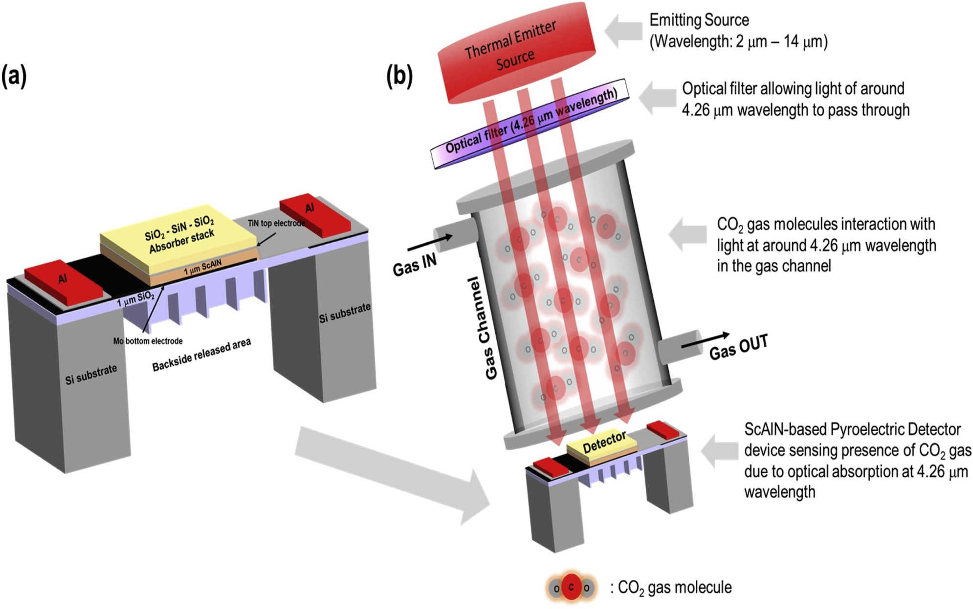
NDIR Gas Sensor Using Pyroelectric Detector

Slide 9
Cont….
Fig. 1a shows a schematic of the ScAlN-based pyroelectric detector
that we use. The pyroelectric detector consists of a pyroelectric sensing
layer with area ~ 500 μm x 500 μm. We use 12 %-doped ScAlN with
thickness of ~1 μm as the pyroelectric sensing layer. On top and below the
ScAlN sensing layer is the top and bottom electrodes respectively. Tita-
nium nitride (TiN) is used as the top electrode and molybdenum (Mo) as
the bottom electrode. Above TiN top electrode is a dielectric stack of
silicon dioxide – silicon nitride – silicon dioxide (SiO2-SiN-SiO2) which
acts as the absorber to help enhance light absorption into the device. This
absorber stack is used to help broaden the absorption bandwidth with 3
layers of dielectric films and create destructive light wave interference in
the stack for more efficient absorption.

Slide 10

Cont….
The top and bottom electrodes are connected to aluminium metal pads which act as metal contacts for electrical connections. Below the bottom electrode is a ~1 μm thick SiO2 layer with waffle-like structures. The SiO2 material helps to thermally isolate the thermal energy received by the pyroelectric detector sensing layer, slowing down thermal conduction to the medium below. In addition, the Si substrate is released from the backside to form an air cavity area under the pyroelectric sensing region to further reduce thermal losses as air is a poor thermal conductor. The SiO2 ribs help to increase the mechanical stiffness of the pyroelectric sensing region which is in membrane form.

Slide 11
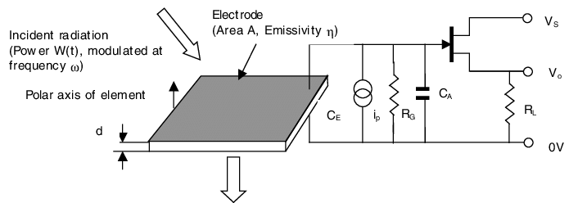
Driver Circuit for Pyroelectric Detector

Slide 12
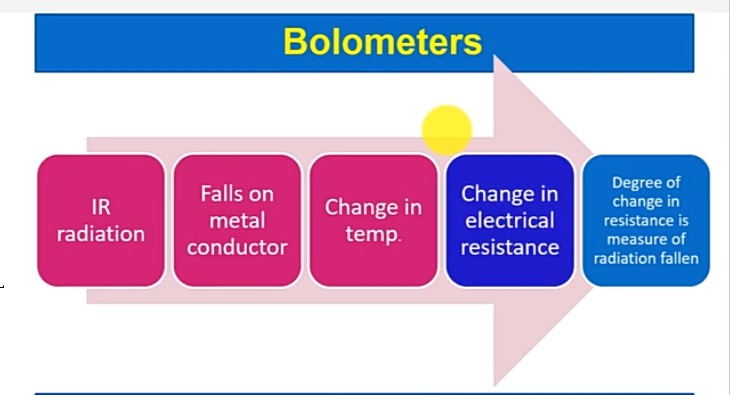
NDIR Gas Sensor Using Bolometer Detector

Slide 13

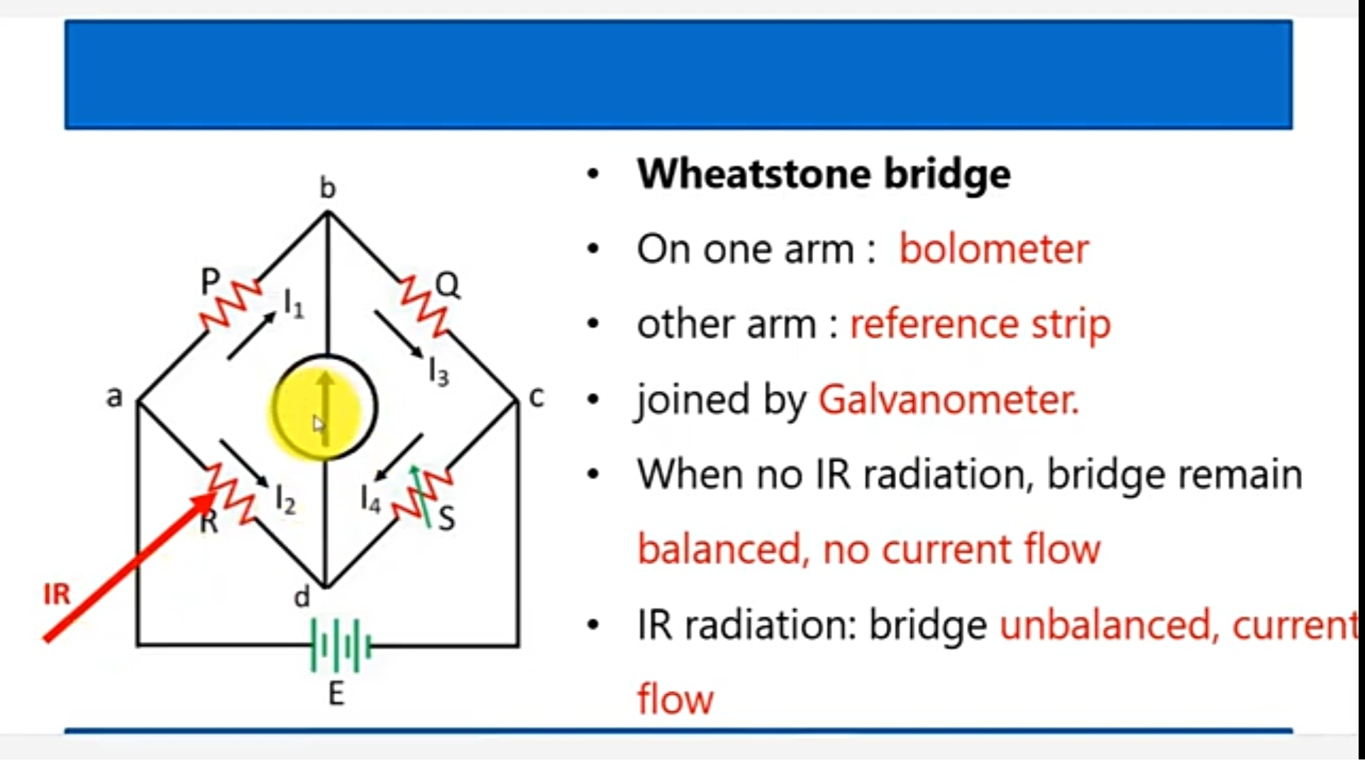
Driver Circuit for Bolometer Detector

Slide 14
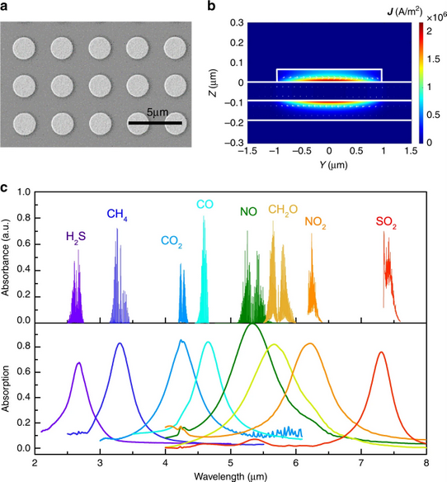
Absorption Spectra of Different IR Active Gases

Slide 15
References
https://www.researchgate.net
https://www.analog.com/
https://www.sciencedirect.com/
https://www.nature.com/
https://www.semanticscholar.org/
https://core.ac.uk/

Slide 16


